Slide 1

CUSTOMER CHURN ANALYSIS IN ECOMMERCE

Slide 2
What is Customer Churn?

Slide 3
What is Customer Churn?
Churn refers to the phenomenon where customers stop doing business with an online retailer or service over a specified period. It is a critical metric as it directly impacts a company's revenue and growth potential. Understanding and managing churn is essential for maintaining a healthy and sustainable customer base.

Slide 4
Defining the business problem and Goal
01

Slide 5
PURPOSE
Analyze customer data to identify patterns and factors that contribute to churn.
Segment customers based on their likelihood to churn using various attributes (e.g., tenure, satisfaction score, order history).
Develop actionable insights and recommendations to Improve customer retention.

Slide 6
PURPOSE
BUSINESS NEEDS
Analyze customer data to identify patterns and factors that contribute to churn.
Segment customers based on their likelihood to churn using various attributes (e.g., tenure, satisfaction score, order history).
Develop actionable insights and recommendations to improve customer retention.
Retaining existing customers is more cost-effective than acquiring new ones.
Segment customers to target retention efforts more effectively.
Analyzing churn helps in identifying and retaining high-value customers, thus maximizing Customer Lifetime Value

Slide 7
PURPOSE
BUSINESS NEEDS
OBJECTIVE
Analyze customer data to identify patterns and factors that contribute to churn.
Segment customers based on their likelihood to churn using various attributes (e.g., tenure, satisfaction score, order history).
Develop actionable insights and recommendations to improve customer retention.
Retaining existing customers is more cost-effective than acquiring new ones.
Segment customers to target retention efforts more effectively.
Analyzing churn helps in identifying and retaining high-value customers, thus maximizing Customer Lifetime Value
Quickly and accurately identify customers who are at high risk of churning.
Reduces the churn rate and increases customer lifetime value.
Use insights from churn analysis to refine marketing and customer engagement strategies.

Slide 8
Defining the business problem and Goal
Identifying and Collecting the relevant data
01
02

Slide 9
DATA OVERVIEW
The dataset contains various attributes related to customer demographics, behavior, and transaction history.
Collected from Kaggle
Total Records: 5630
Total Attributes: 20
The dataset belongs to a leading online E-Commerce company.

Slide 10
BUSINESS QUESTIONS
Is there a relationship between Gender and churn? & Which gender has more orders?
How are customers distributed across diverse city tiers?
Which payment mode emerges as the preferred choice among churned customers?
What characterizes the typical tenure of churned customers?
Is there a discernible churn rate disparity between male and female customers?
How does the average app usage duration differ between churned and non-churned customers?
Is a relationship discernible between customer satisfaction scores and churn?
Does the marital status of customers influence churn patterns?
Do customer complaint correlate with churn behavior?

Slide 11
Defining the business problem and Goal
Identifying and Collecting the relevant data
Data cleaning and Transformation
01
02
03

Slide 12
Data Preparation
Determining the total count of customers
Identifying and addressing duplicate rows
Deriving a new measure from the existing “Churn” column
Creating a new column from the existing “tenure" column.
Validating values in each column for accuracy and consistency.

Slide 13
Defining the business problem and Goal
Identifying and Collecting the relevant data
Data cleaning and Transformation
Analyze the Data
Visualize and comm-unicate the Data
01
02
03
04
05

Slide 14
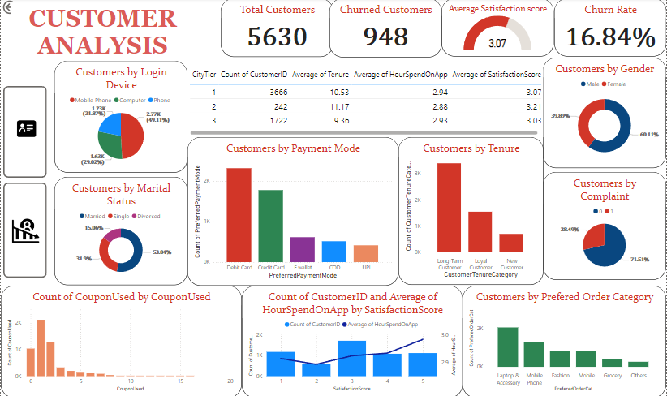

Slide 15
Insights: Customer Analysis
There were 5630 customers this month: 3384 males and 2246 females.
The average satisfaction score is 3.07.
60.37% of customers are long-term users(more than 5 years).
Customers spend an average of 2.9 hours on the app.
28.5% of customers raised a complaint last month.
41.1% of customers prefer to use debit cards for payment.
53.04% of customers are married.
The most frequently purchased products are mobile phones, followed by laptops and accessories, and fashion items.

Slide 16
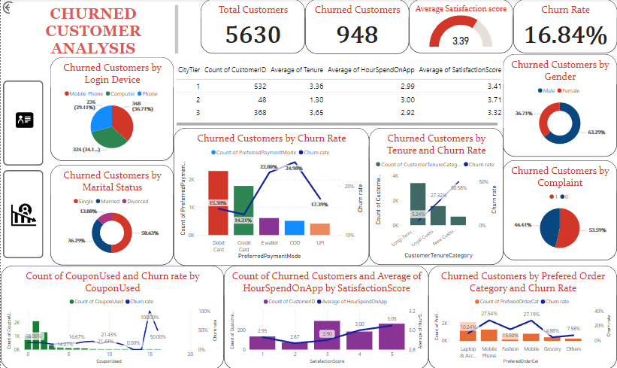

Slide 17
Insights: Customer Churn Analysis
948 customers churned, resulting in a 16.84% churn rate.
63.29% of those who left were women; 36.71% were men.
New customers (less than 1 year) had a 50.2% churn rate.
“Cash on Delivery” and “E-wallet” payment modes have higher churn rates, while “Credit Card” and “Debit Card” have lower churn rates, indicating influence of payment preferences on churn.
Most customers who churned had a satisfaction score of 3.
Among churned customers, 46.41% did not raise a complaint, while 53.59% raised a complaint.
Customers who prefer to buy mobile phones exhibit a high churn rate.
Single customer have the highest churn rate compared to customers with other marital status

Slide 18
Recommendations
Focus on improving the onboarding experience and early engagement for new customers, as they have a significantly higher churn rate of 50.2%.
Note that most churned customers had a satisfaction score of 3. This indicates a neutral sentiment, suggesting there's room for improvement in overall customer satisfaction. Enhance product or service features based on feedback to elevate satisfaction levels.
Given that over half of the churned customers raised a complaint and still churned, focus on improving the complaint resolution process.
With 60.37% of customers being long-term, focus on retention strategies tailored to their needs. Offer loyalty programs, VIP benefits, and special promotions to strengthen their loyalty and reduce churn risk.

Slide 19
Thank You!

